Slide 1







AI Fake News Detector
A Collaborative Mini Project

Slide 2




Introduction to Fake News Detection
OVERVIEW OF PROJECT GOAL AND LOGIC
KEY ASPECTS OF FAKE NEWS
PROJECT LOGIC AND APPROACH
Misinformation
Viral Spread
Public Trust
Keyword Scoring
Confidence Percentage
Easy GUI

Slide 3




Importance of Fake News Today
Real-World Relevance and AI Logic Overview
Real-World Relevance
Widespread misinformation
Public trust erosion
Social polarization
AI Logic Overview
Keyword scoring
Simple classification
No ML needed

Slide 4





News Classification Objectives
The project aims to classify news articles as Fake, Real, or Uncertain, providing a confidence percentage for each classification. This ensures users receive accurate information in today's digital landscape.

Slide 5




TECH STACK OVERVIEW FOR AI PROJECT
TOOLS AND TECHNOLOGIES USED
PROGRAMMING LANGUAGE AND FRAMEWORK
KEYWORD DATASET FEATURES
Python 3
Tkinter
Easy GUI
Custom weighted
Keyword selection
Real vs fake

Slide 6


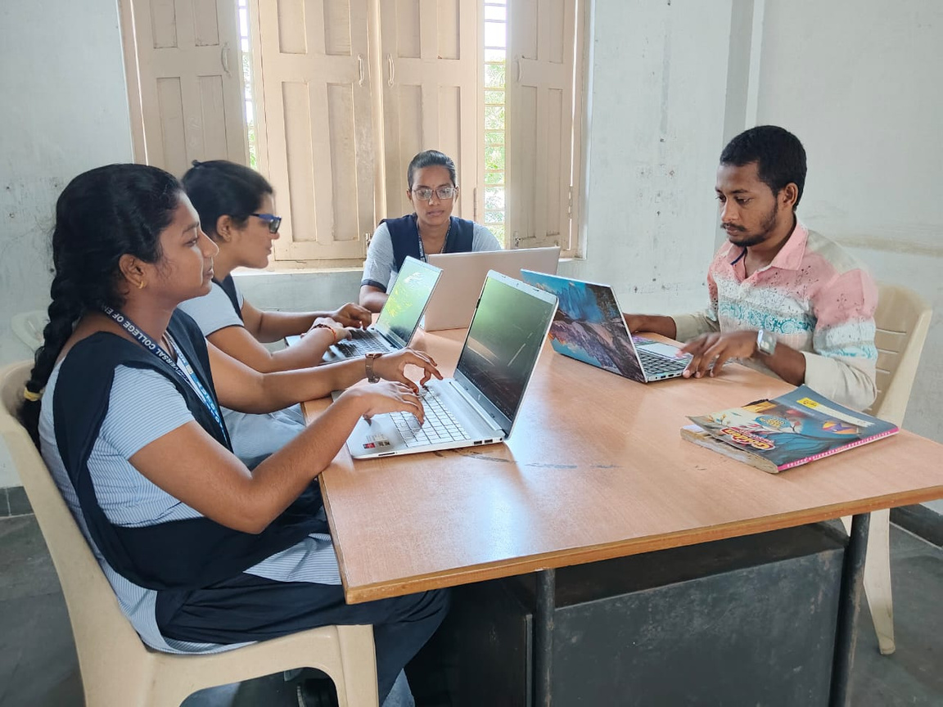

Our Team's Collaborative Journey

Slide 7




Dataset and Keyword Selection
The keywords play a crucial role in detecting fake news. We selected and weighted terms based on their relevance, ensuring a robust detection mechanism. Here are some sample words for detection.

Slide 8

Detection Logic and Workflow
Example Input/Output Workflow
Keyword Scoring Mechanism
Demonstrates how news is classified as Fake or Real
Assign scores based on weighted keywords found

Slide 9





GUI Implementation: Tkinter Design
The Tkinter design enhances user experience with color-coded outputs, allowing users to easily identify the classification of news articles. The intuitive layout ensures seamless navigation and interaction.

Slide 10





Testing and Debugging Strategies
Effective testing is essential for input validation and bug fixing. By comparing actual results to expected outcomes, we can ensure the application functions correctly and meets user needs.

Slide 11




Integration and Real-Time Demo
MODULE COMBINATION
REAL-TIME FUNCTIONALITY
Seamless integration of all project modules ensures efficiency
Demonstrates how the detector works with live data

Slide 12
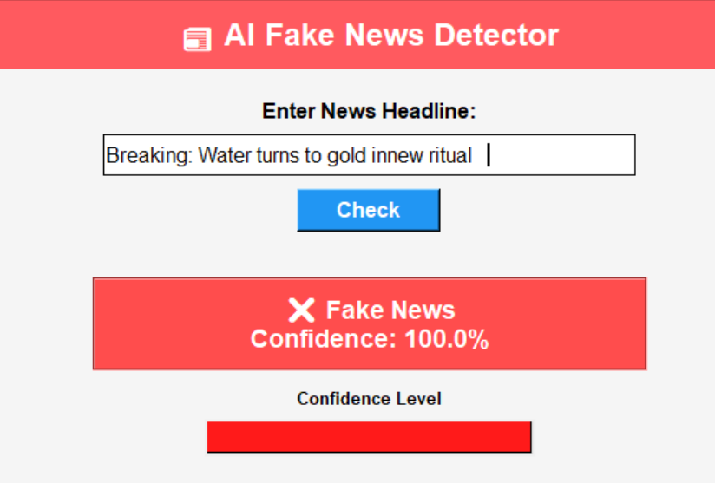
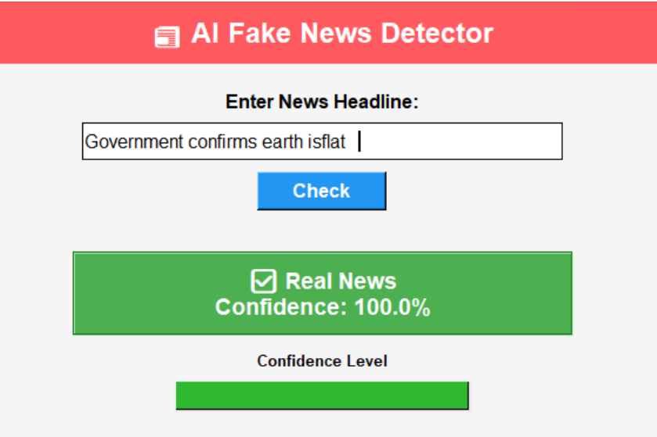
EXAMPLE INPUT/OUTPUT WORKFLOW
Demonstrates how news is classified as Fake or Real

Slide 13




Conclusion and Future Scope
SUMMARY OF OUTCOMES AND FUTURE IDEAS
FUTURE DEVELOPMENT IDEAS
PROJECT OUTCOMES
Effective detection
User-friendly interface
Collaboration success
Live API integration
Incorporate ML models
Expand keyword dataset

Slide 14



Acknowledging Our Supporters
We thank our trainer and faculty for their guidance.
Team Collaboration Highlights
Thank You and Acknowledgments
Our teamwork made this project successful and rewarding.
Invitation for Questions
We welcome your queries and appreciate your feedback.
Future Endeavors
We look forward to exploring and enhancing this project further.

